Slide 1
Group 4
Robert Montgomery
Jarred Wilson
Malcolm Frank
Macauley Odinaka
Dickson Diku
Abebe Adamu

Slide 2

Travelport is a travel e-commerce platform focused on providing distribution, technology, payment and other solutions for travel and tourism industry. This platform enables travel providers, agencies, corporations and developers to search, share,buy and sell travel.

Slide 3
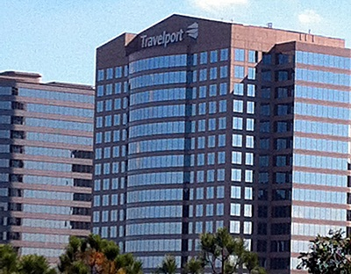
TravelPort at Cumberland
Len Greski is the VP of Software Engineering and leads the Platform Services Technology team at Travelport.

Slide 4
What your app/project is meant to do?
Design cache application that can scale to 100 billion requests per month at associated peak usage
Be able to write/read data to cache
Reduce latency and meet fault tolerance requirements
Research technologies in the in-memory database space, and select a technology with which to build the proof concept application
Develop a solution architecture that eliminates the single points of failure associated with a number of in-memory database technologies.

Slide 5
What problem does it solve?
Our proposed solution architecture will allow Travelport to implement a caching strategy that will optimize the request/response time associated with search processes.

Slide 6
Most popular in-Memory Database
Redis
Couchbase
ManCache
Oracle Time Ten
Apache Cassandra

Slide 7
Most popular in-Memory Database
Redis
Couchbase
ManCache
Oracle Time Ten
Apache Cassandra
Amazon elasticache

Slide 8
Methodology
We using Scrum software methodology with 2-weeks sprints. Scrum is one of the most popular frameworks for implementing agile. So popular, in fact, that many people think scrum and agile are the same thing.

Slide 9



What technologies are you using?
+
+

Slide 10
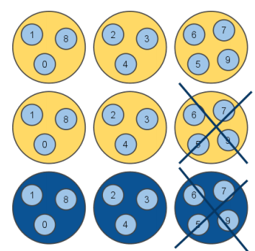
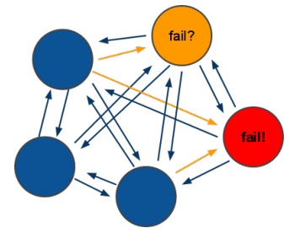
Why Redis?
Familiar within the company
Scalable
Speed
Supports Clustering
Redundancy
Open Source
Testable

Slide 11
DEMO

Slide 12
What else needs to be completed
Funding/Support from client
Research Documentation
Proof of Concept

Slide 13
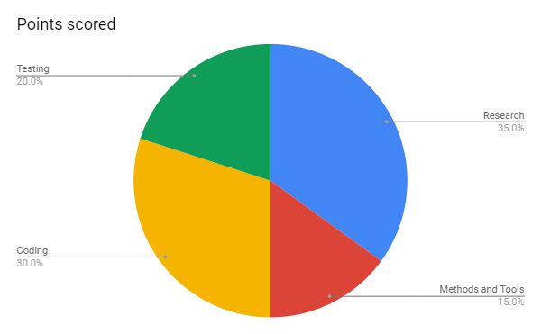
Project’s completion on a scale of 10% to 100%
50% Completed

Slide 14
Any other remarks or open issues
We need at least 10 servers to test the scalability of 100 billion requests per month at associated peak usage. Currently we have not been provided sufficient equipment to build a proof of concept.
Amazon elasticache has limits on the number of requests that can be made.

Slide 15

Comments/Questions

